Slide 1
AR FOOD MENU USING UNITY
MINI PROJECT IV
KESAVAN M(171CS184)

Slide 2
Modules
Scenes
AR camera
3D Objects
Scripts

Slide 3
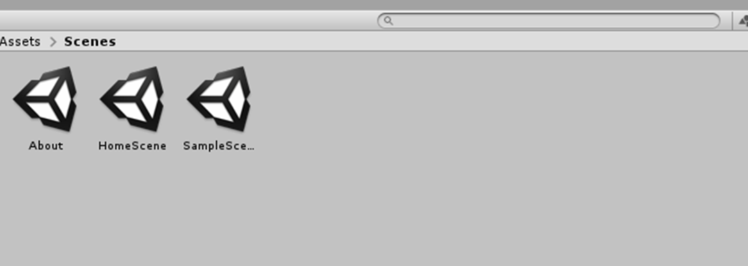
Scenes
Scenes contain the environments and menus of your project.
each unique Scene file as a unique level
Specific page in a Application.

Slide 4
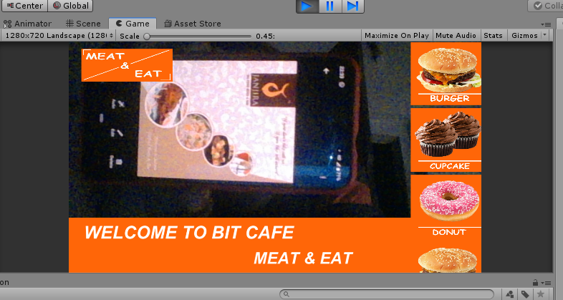
AR Camera
AR Camera is like a Normal camera.
Used to scan and recognize the targeted image.
In this project Target image is Menu Card.

Slide 5
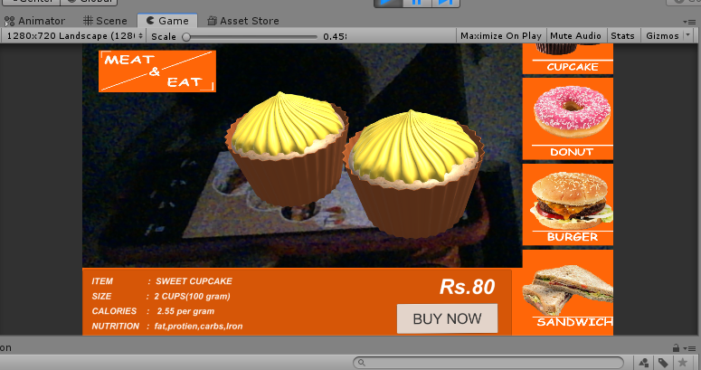
3D Objects
Here 3D Models are food Items. These 3D objects were created using Blender.
Selecting foods on right side, separate 3D object will be display.

Slide 6
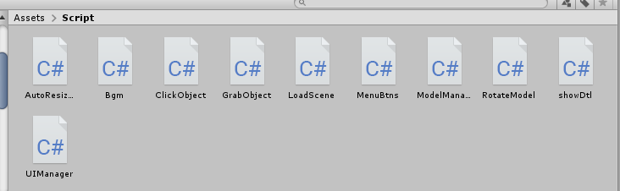
Scripting
C# is a Scripting language in Unity.
Every functions are working using script component.

Slide 7
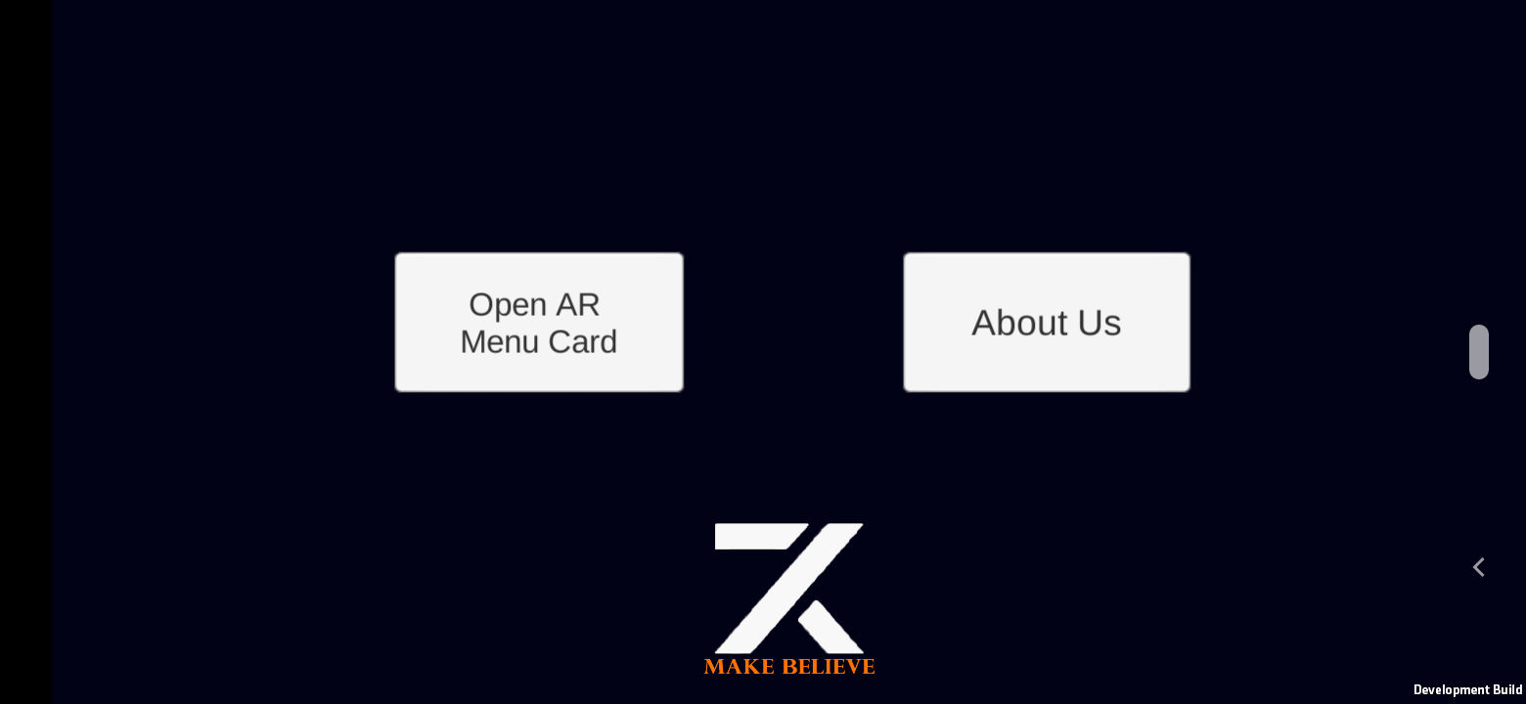
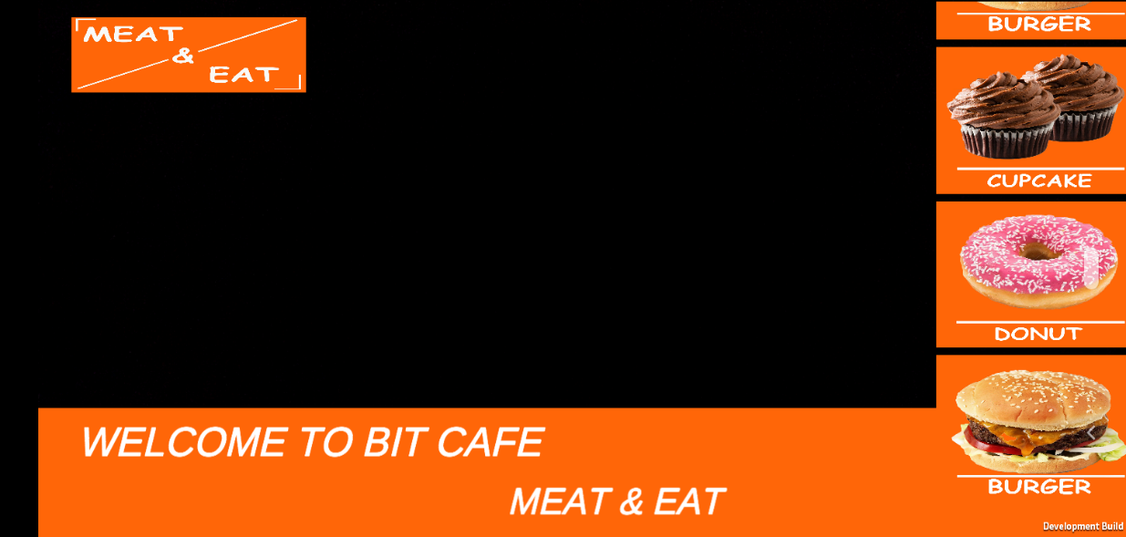
Working Screenshot

Slide 8
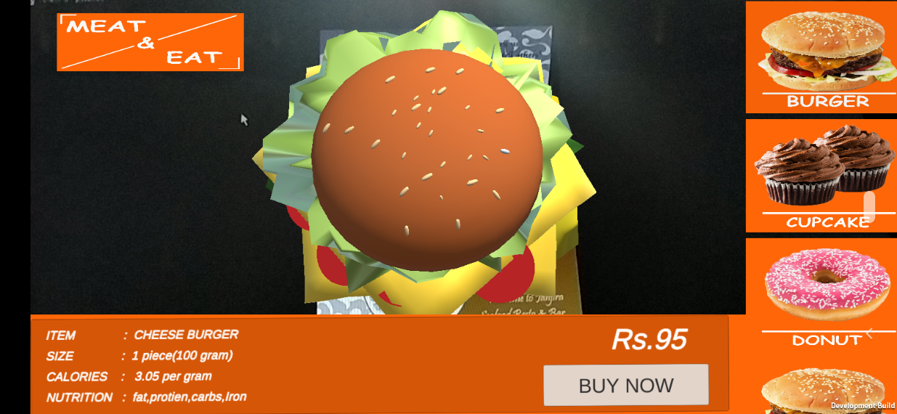
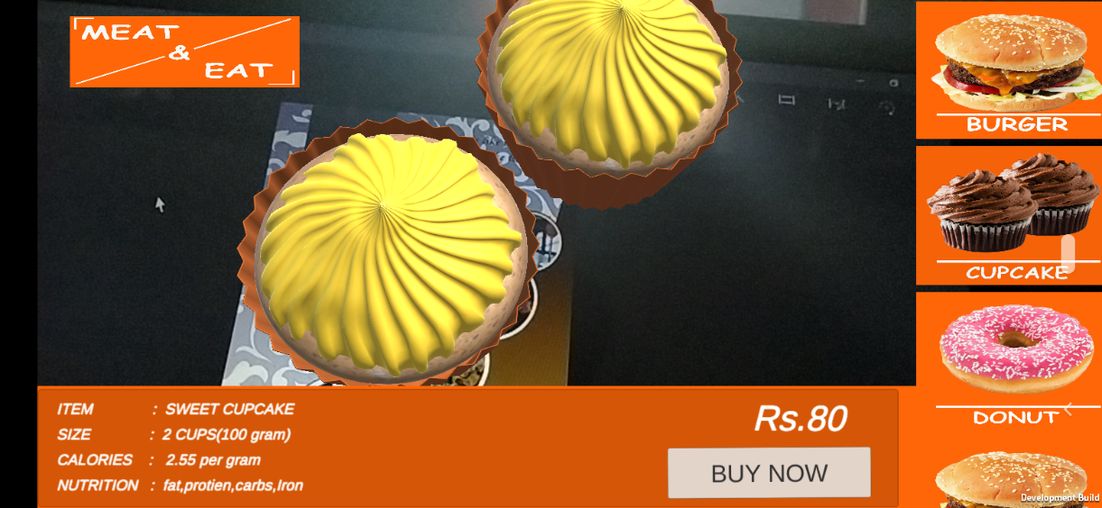

Slide 9
CONCLUSION
Hence the App runs good on all the versions of Android. This App is fine and all the controls are working. The 3D view of foods are quite interesting to see using this application.

